Slide 1

BLUESTOCK
Mutual Fund Analytics Platform
ETL pipeline, quantitative performance analytics, and a 4-page Power BI dashboard covering 40 mutual fund schemes (2022–2026)
Anwesha Ghosh
B.Tech CSE — Institute of Engineering and Management, Kolkata
Data Analyst Intern, Bluestock Fintech | June 2026

Slide 2
Problem & objective
India's mutual fund industry has grown rapidly, but fund houses and analysts often lack a unified view connecting raw scheme data, investor behaviour, and quantitative risk metrics in one place.
1
2
3
Unify the data
Quantify performance
Surface insights
Combine 10 raw datasets and a live NAV API into a single queryable SQLite warehouse.
Compute CAGR, Sharpe, Sortino, Alpha/Beta, drawdown, VaR/CVaR for all 40 schemes.
Deliver a 4-page interactive Power BI dashboard for industry, fund, and investor analytics.
₹68+ lakh crore Indian mutual fund industry AUM — the scale this analytics platform is built to navigate

Slide 3
Data sources
10 structured CSVs plus a live NAV feed, spanning January 2022 to June 2026
Dataset | Description | Rows
01_fund_master.csv | Scheme metadata — fund house, category, risk grade, expense ratio | 40
02_nav_history.csv | Daily NAV history per scheme | 52,400+
03_aum_by_fund_house.csv | Monthly AUM per AMC, 2022–2025 | 480
04_monthly_sip_inflows.csv | Industry-wide monthly SIP inflow totals | 48
05_category_inflows.csv | Net inflow by fund category, monthly | 144
06_industry_folio_count.csv | Industry folio count, monthly | 48
07_scheme_performance.csv | 1Y/3Y/5Y returns, Sharpe, expense ratio | 40
08_investor_transactions.csv | SIP / Lumpsum / Redemption transactions | 15,000+
09_portfolio_holdings.csv | Sector-level portfolio weights per scheme | 320
10_benchmark_indices.csv | Nifty 50 / Nifty 100 daily values | 2,280
Live NAV API (mfapi.in) | Real-time NAV fetch for HDFC Top 100 + 5 bluechip schemes | 6 endpoints

Slide 4
Architecture
Raw CSVs and a live NAV API flow through ETL into a star-schema SQLite database, powering both the Python analytics layer and the Power BI dashboard
Raw data
ETL pipeline
SQLite DB
Analytics layer
Power BI + recommender
10 CSVs + live API
Clean & validate
Star schema, 6 tables
Quant metrics, EDA
4-page dashboard, CLI tool
Star schema — SQLite database
dim_fund
Scheme metadata
fact_transactions
SIP/Lumpsum/Redemption
fact_nav
Daily NAV records
dim_date
Calendar attributes
fact_performance
Returns, Sharpe, etc.

Slide 5
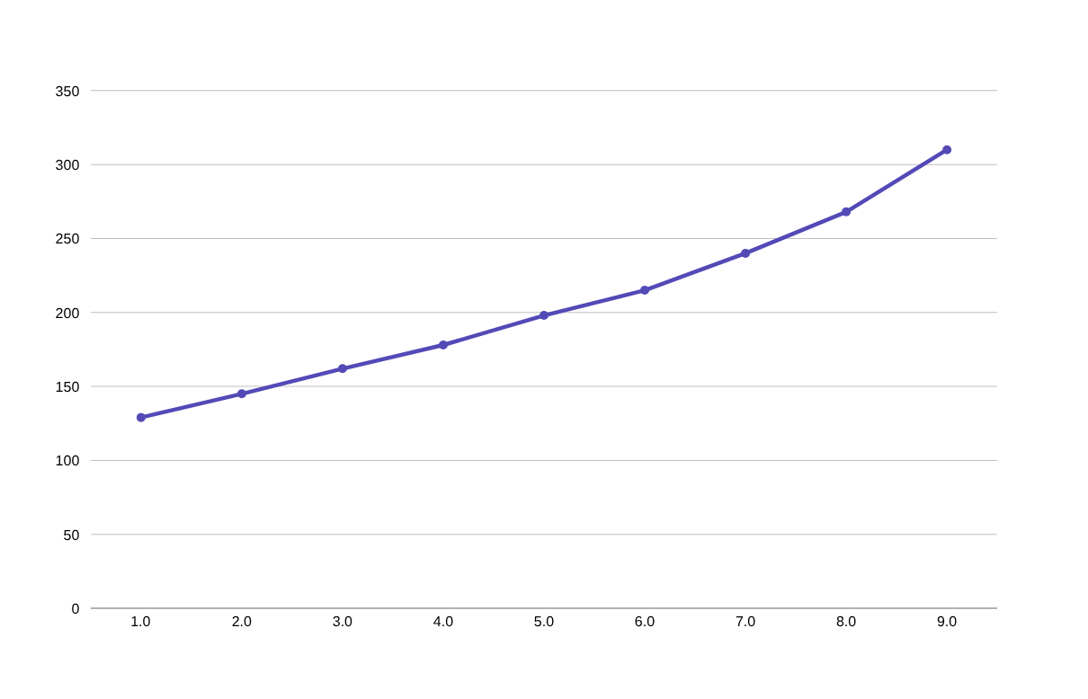
SIP inflows hit an all-time high
2.4× growth
in monthly SIP inflows
From ₹12,900 Cr (Jan 2022) to ₹31,002 Cr (Dec 2025) — a clear signal of sustained retail SIP adoption across the Indian mutual fund industry.
December 2025 marks the all-time high, with a steady upward trend through 2024–2025.
₹31,002 Cr all-time high SIP inflow recorded in December 2025

Slide 6
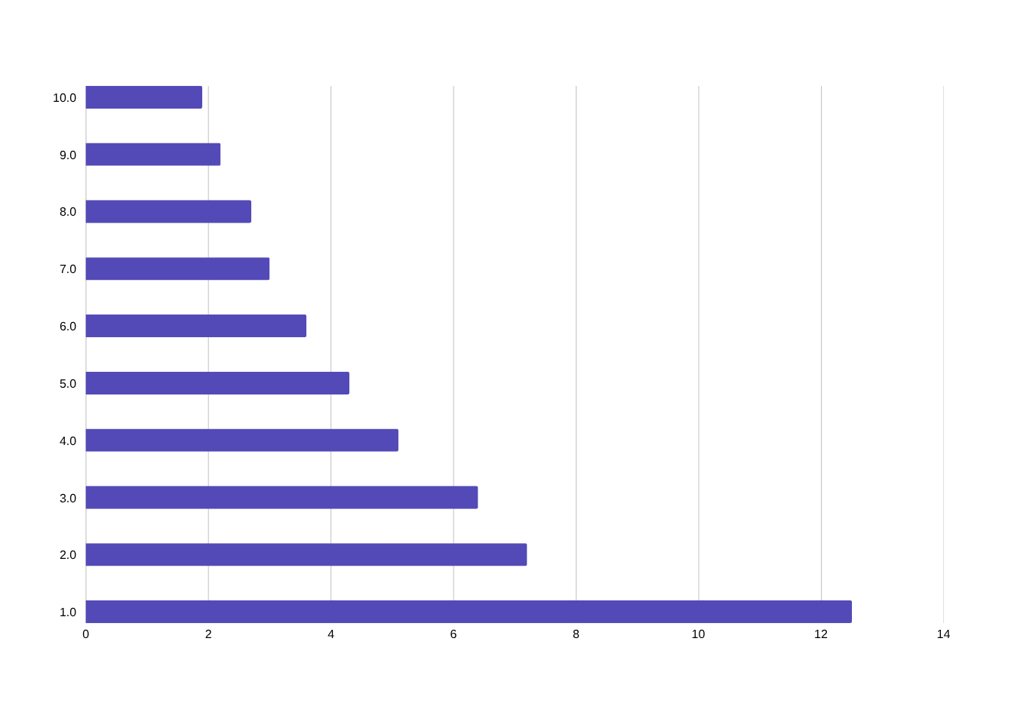
SBI Mutual Fund leads industry AUM
Total assets under management by fund house, 2025 (₹ lakh crore)
₹12.5L Cr
SBI Mutual Fund — industry-leading AUM in 2025
∼1.7×
SBI's lead over the second-largest AMC (HDFC, ₹7.2L Cr)
Bank-led distribution networks are a key driver of AUM concentration among top AMCs.

Slide 7
Fund performance: CAGR & risk-adjusted returns
Top 5 funds by 3-year CAGR, with Sharpe ratio for risk-adjusted comparison
Scheme | 1Y CAGR | 3Y CAGR | Sharpe | Score | Rank
Axis Midcap Fund — Regular — Growth | 22.26% | 35.11% | 0.73 | 81.38 | 2
ABSL Frontline Equity Fund — Regular — Growth | 47.92% | 28.97% | 0.72 | 59.31 | 15
Axis Bluechip Fund — Direct — Growth | 19.77% | 20.82% | -0.05 | 52.88 | 18
ABSL Small Cap Fund — Regular — Growth | -23.99% | -4.15% | 0.06 | 30.81 | 30
ABSL Liquid Fund — Regular — Growth | 7.24% | 6.32% | -4.64 | 23.50 | 37
1.24
Highest Sharpe ratio in the portfolio — SBI Bluechip Direct, indicating the best return per unit of risk among all 40 schemes.
Axis Midcap Fund tops the scorecard
with the highest composite score (81.38/100) — driven by a 35.11% 3-year CAGR and the strongest Sharpe ratio (0.73) among top performers.

Slide 8
Fund scorecard: composite ranking methodology
Each fund's score (0–100) is a weighted blend of five percentile-ranked components
30%
25%
20%
15%
10%
3Y CAGR
Sharpe ratio
Alpha (annual)
Expense ratio (inv.)
Max drawdown (inv.)
Score = 0.30×CAGR3Y_rank + 0.25×Sharpe_rank + 0.20×Alpha_rank + 0.15×(1−ExpenseRatio_rank) + 0.10×(1−MaxDD_rank)
Top 5 funds by composite score
Rank | Scheme | 3Y CAGR | Sharpe | Alpha (ann.) | Score
1 | Axis Midcap Fund — Regular — Growth | 35.11% | 0.73 | 26.00 | 81.38
2 | ABSL Frontline Equity Fund — Regular — Growth | 28.97% | 0.72 | 21.39 | 59.31
3 | Axis Bluechip Fund — Direct — Growth | 20.82% | -0.05 | 8.33 | 52.88
4 | Mirae Asset Large Cap Fund — Regular — Growth | 34.00% | 1.05 | 27.12 | 79.38
5 | ICICI Pru Midcap Fund — Regular — Growth | 31.78% | 0.90 | 29.30 | 84.50

Slide 9
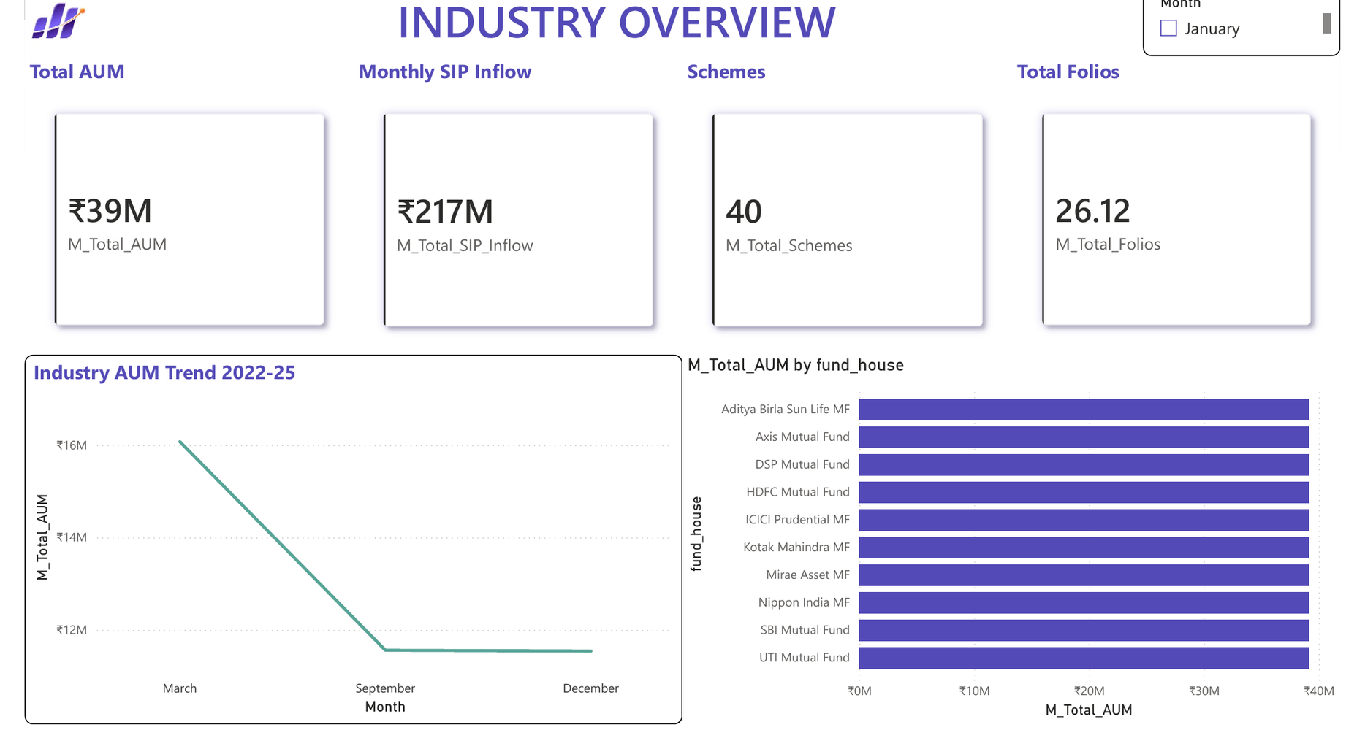
Dashboard — Industry Overview
Power BI Page 1 — KPI cards, AUM trend, and AMC comparison

Slide 10
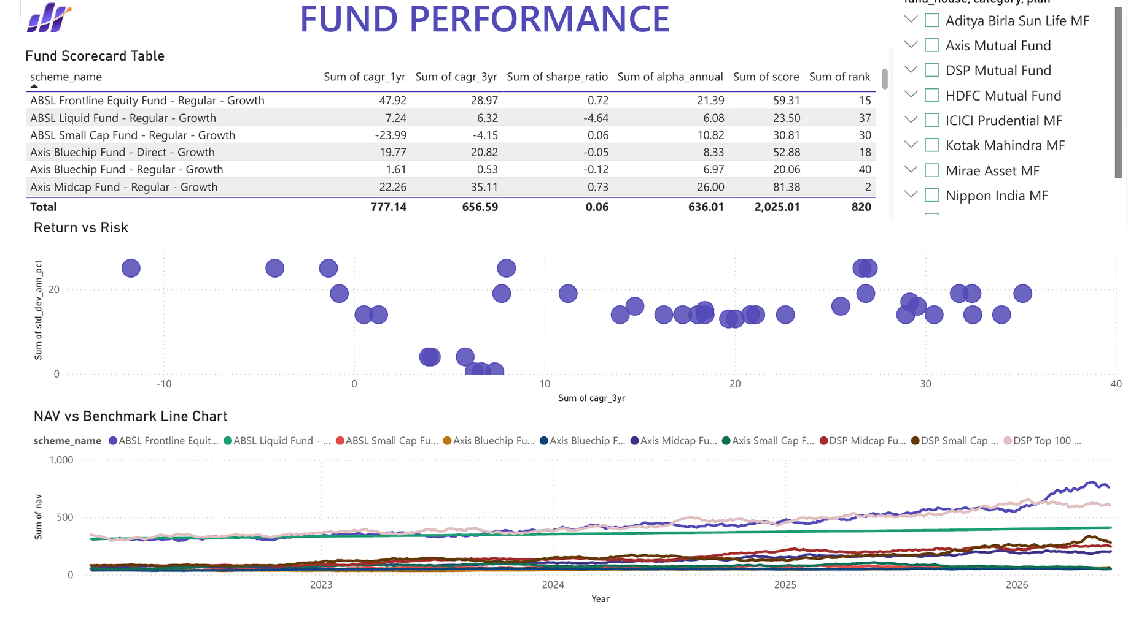
Dashboard — Fund Performance
Power BI Page 2 — Scorecard table, return vs. risk, and NAV vs. benchmark

Slide 11
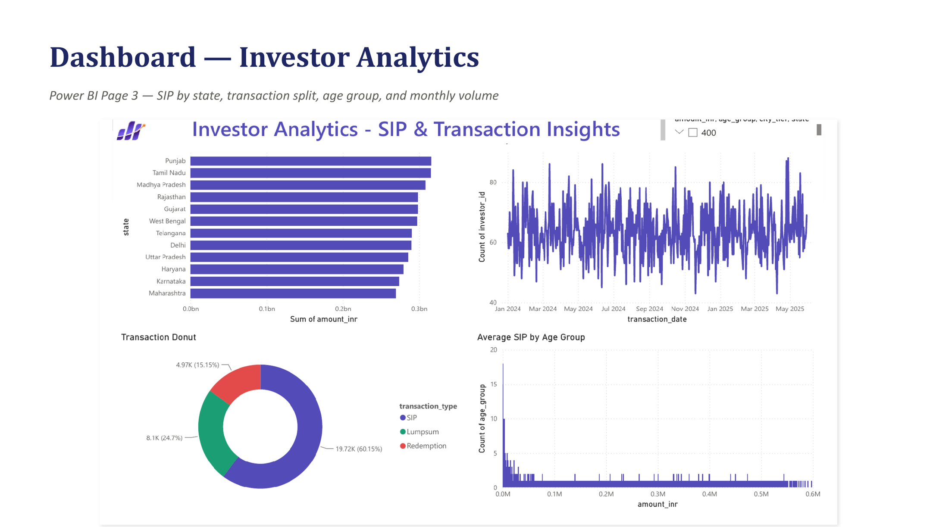

Slide 12
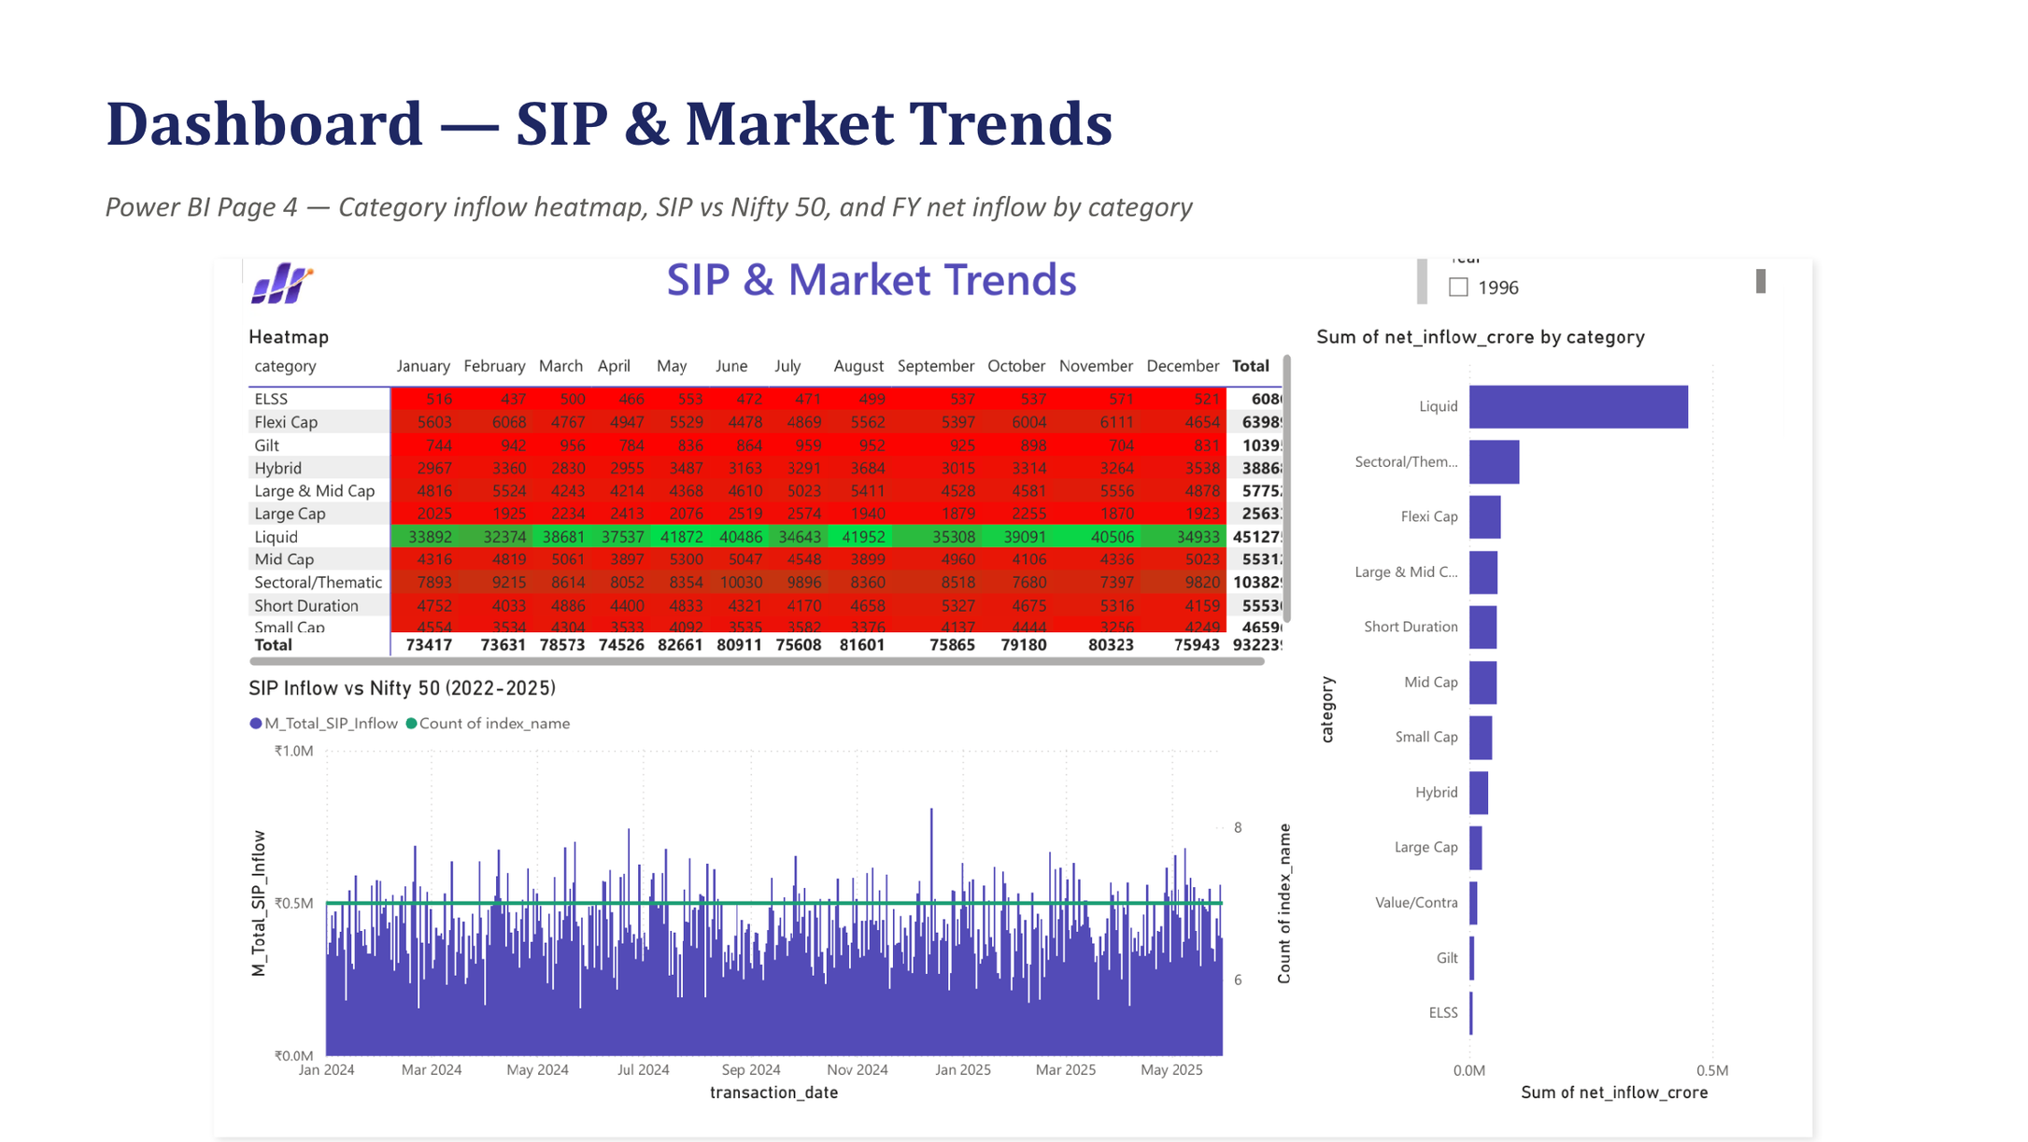

Slide 13
Key findings
2.4×
SIP inflows grew from ₹12,900 Cr to ₹31,002 Cr (Jan 2022 – Dec 2025)
₹12.5L Cr
SBI Mutual Fund leads industry AUM — nearly 1.7× the next-largest AMC
1.24
Top Sharpe ratio achieved by SBI Bluechip Direct — best risk-adjusted return
27%
of regular SIP investors are flagged “at-risk” (avg. payment gap > 35 days)
26.12 Cr
industry folio count in Dec 2025 — double the 13.26 Cr recorded in Jan 2022

Slide 14
Thank you
Anwesha Ghosh
B.Tech CSE, Institute of Engineering and Management (IEM), Kolkata
Data Analyst Intern, Bluestock Fintech
GitHub: github.com/anweshaghosh06/bluestock-mf-capstone
Email: anweshagh1906@gmail.com
LinkedIn: https://www.linkedin.com/in/anwesha-ghosh-666848333/

